Slide 1
My Holocaust Survivor
By: Mark Martin, Harrison Ormes, and Dylan Jones

Slide 2
Definitions
Hebrew school -Afterschool or weekend classes for children in hebrew and jewish subjects.
Yellow star-A badge Jews were ordered to wear in Germany or Nazi occupied countries in order to distinguish and isolate them from surrounding populations.
Deportation-The forced relocation of Jews during the holocaust.
Selection-During the Holocaust, a process in which those who were deemed unfit for work were sent to be killed.
Labor Camp-A concentration camp that took advantage of the slave labor of inmates.

Slide 3
Pre-deportation
Ellie grew up in Samorin, Czechoslovakia in a small town near Bratislava. She lived with her parents and her one brother; other family members lived by them like over the border in hungary. Her father owned a well know store. Ellie loved talking to other people that came to her father's store. Ellie often played with friends that were not jewish.

Slide 4
Deportation
In 1938 when Ellie was seven years old her town was taken over by hungary. Her mother thought that life would be better with Hungarians, but none of them knew that they were collaborating with the Nazis. As they marched into town they sang vicious anti-semitic songs. At that moment life became more difficult for Elli and her family. They began by closing the Friedmann's store, second they began to impose special laws for Jews. There were laws that allowed the Jews such as keeping the Jews from having kosher, reading the newspaper, and not allowing them to listen to the radio.

Slide 5
Post-Deportation
Elli was 20 years old when she came to New York, she entered college as soon as she landed and eventually became a history professor. She has written several books about her experiences in and after the holocaust. As an adult she separates her time between israel and the U.S.

Slide 6
Timeline
1938:
Hungarians close the Friedmann store
1944:
Germans occupy Hungary
1944:
Friedmann family sent to Nagymagyar ghetto
1944:
Friedmanns deported to Auschwitz
1944:
Elli and her mother are deported to Plaszow
1944:
Elli and her mother are returned to Auschwitz
1944:
Elli and her mother are transported to Augsburg
1945:
Elli, her mother, and brother are liberated; return to Samorin; Armin moves to the U.S.; Elli and her mother move to Bratislava
1951:
Elli and her mother arrive in the United States

Slide 7
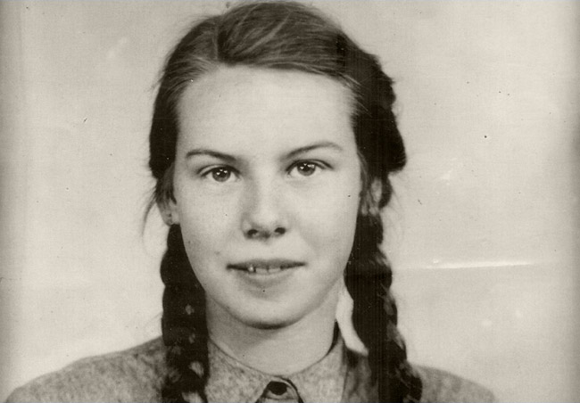
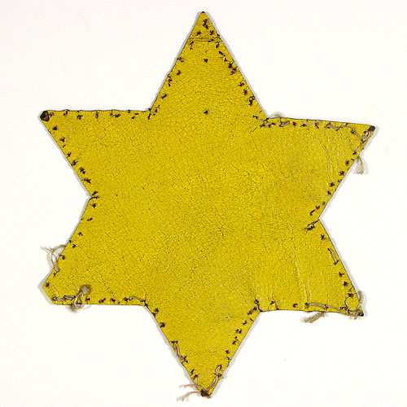
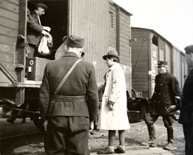
Elli before the holocaust at age13.
Jews had to wear this star because of the Nazis.
Jews being moved the different concentration camps.

Slide 8
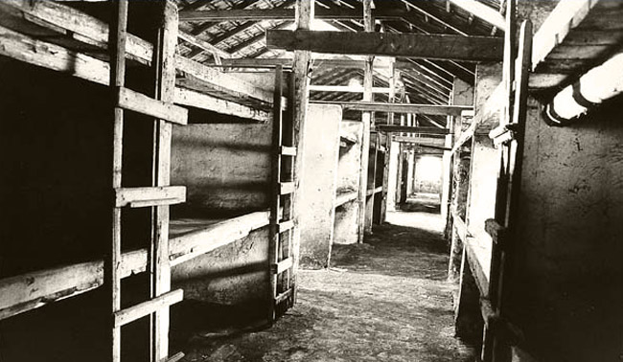
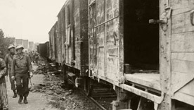
These are baracks that the jews stayed in while in the concentration camps.
The American M.P. inspecting the Nazi train.

Slide 9
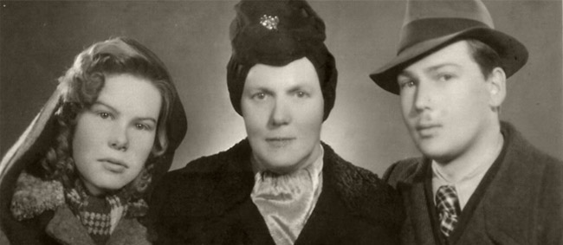
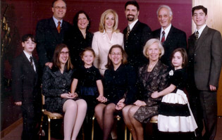
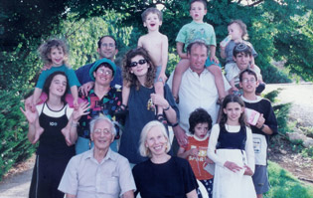
Ellie, her mother, and brother one and a half years after the holocaust
Elli and her family today.
Elli and her family.

Slide 10
What’s it like?
Imagine being beaten to nearly death ,and worked until you collapse all at a very young age of thirteen. My survivor of the holocaust ,Elli Friedman,went through this horrible thing. I could not even imagine how she felt. If you where a teenage in the holocaust you would be worked to death, beaten, and have so little sleep you would be exhausted. You would never be able to see your family and never get to celebrate your holidays. On top of that if u die u would not have a proper funeral but would be thrown in a burn pile and cremated.

Slide 11
Profound statement
“We were loaded onto trains and we were taken away to – we didn’t know where.”
—Elli Friedman
This quote talked to me because, they were loaded on trains to be taken somewhere they don’t know about and they had to go or else be killed. I don’t know about you but if I had to be loaded on trains to be taken somewhere that I don’t know I would start freaking out.

Slide 12
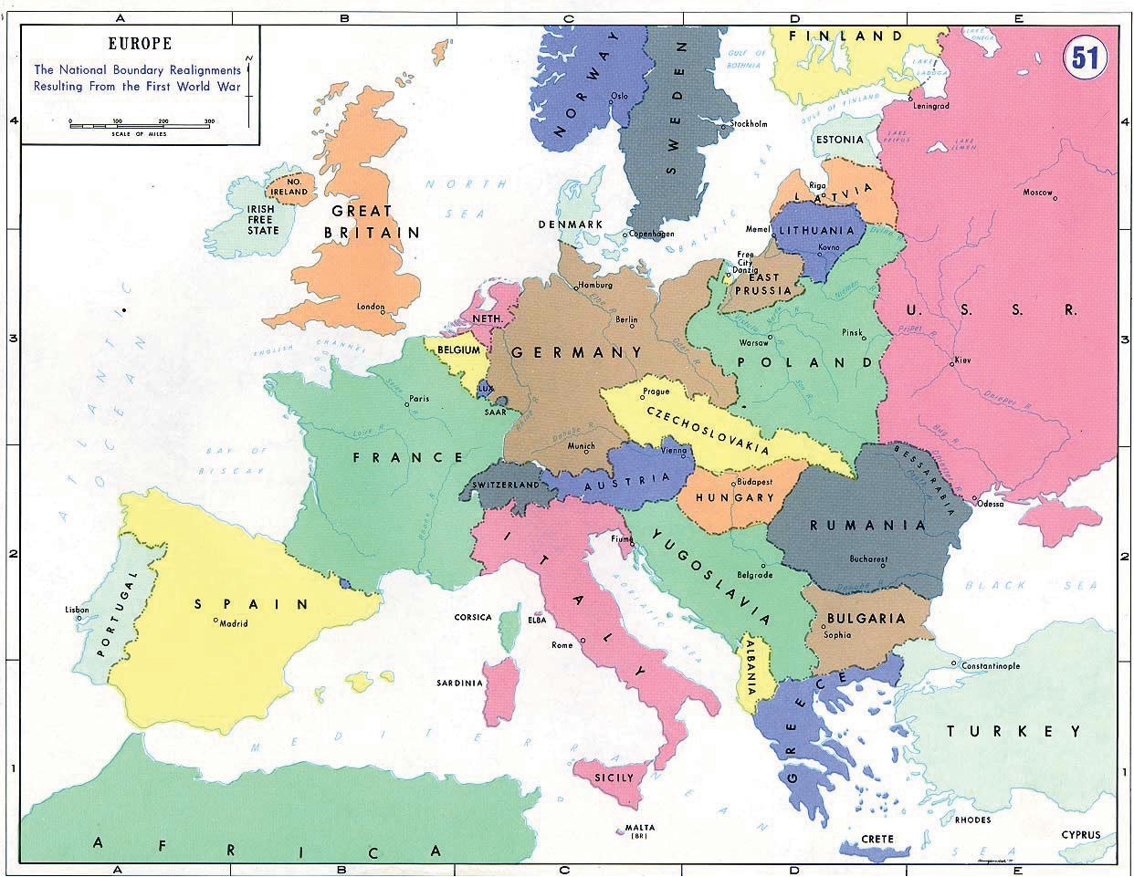
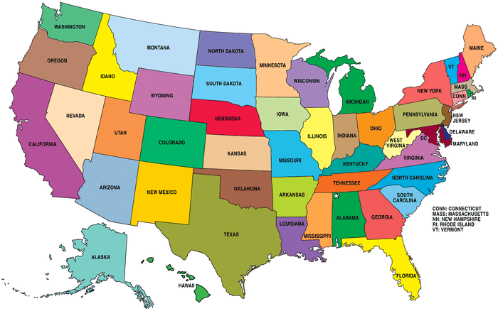
Where Elli started before deportation and after the holocaust she ended in Albany, New York

Slide 13
Sources
http://images.flatworldknowledge.com/trowbridge2_1.0/trowbridge2_1.0-fig05_028.jpg
http://comingofagenow.org/survivor-stories/ellis-story/ellis-story-page-3/
http://cdn.playbuzz.com/cdn/683c4868-68bb-426a-9e3c-ae2882ff4e2d/43bda35a-4f6a-4a09-b6b4-986cac69a98e.gif

